Slide 1
Click-To-Dial API
China Mobile, Huawei
Contacts: wanghanbai@chinamobile.com,qingshuting1@huawei.com

Slide 2
Contents
API Overview
API Benefits
API Family
Click To Dial Architechture
Technical Viability

Slide 3


Click To Dial API Overview
Introduction
Click-to-dial API allows users initiates a two-way call request in the webpage or APP by calling the API interface, dials the calling party and the called party in turn, and establishes a point-to-point voice call between the calling party and the called party after they both answer the call.
Business Scenarios
Delivery scenarios: express delivery, takeaway delivery
Counselling services: psychological, legal, health counselling
When a courier dispatches a shipment, they can establish a call with the user by Click To Dial API, but neither knows the other's real number, protecting the number privacy of both parties in order to avoid information leakage.
With the click-to-dial capability, you can hide the number information of both sides of the call to protect the user's privacy and reduce the user's psychological burden, and the voice quality is greatly improved, so the consultation effect is more significant.

Slide 4
API Benefits
Protection of Privacy
Flexible Application
The terminals of both sides of the call only display the system access code to protect the privacy of both sides of the call.
Customized by the developer of using scenario.The API can be called from PC or APP.
Efficiency Improvement
High Voice Quality
Reduce the tedious operation of calls between employees of enterprises and improve the overall office efficiency of enterprises.
Carrier-grade voice quality with high reachability

Slide 5
API Family
API name | API function
Click to Dial create | Establish a call for the calling and called users
Click to Dial query | Use this API to send a notification to the app after the call is established,providing: Call Status
Click to Dial termination | Terminate two-party calls.
using-method

Slide 6
Click To Dial API Overview
Introduction
Click-to-dial API allows users initiates a two-way call request in the webpage or APP by calling the API interface, dials the calling party and the called party in turn, and establishes a point-to-point voice call between the calling party and the called party after they both answer the call.
Protection of Privacy
Efficiency Improvement
Flexible Application
High Voice Quality
Using-Method

Slide 7
Click To Dial Architecture

Slide 8
Technical Viability -IMS network element requirements
The IMS network consists of network elements such as CSCF, HSS, MRF, etc. The SIP protocol (as defined by IETF RFC 3261) is used to realise voice functions such as subscriber registration, call initiation and session establishment. See TS 23.228 IP Multimedia Subsystem (IMS), TS 23.237 IP Multimedia Subsystem (IMS) Service Continuity; Stage 2 and other 3GPP specifications.

Slide 9
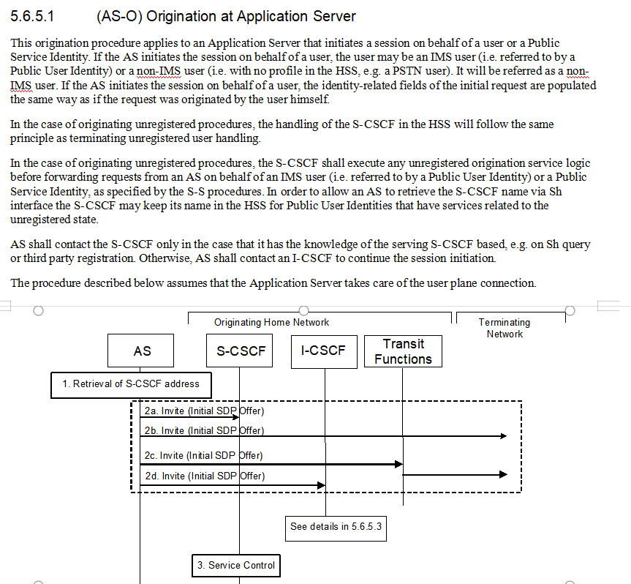
Technical Viability
-Click to Dial Create
Click to Dial create relies on two main functions for its implementation.
The first is the function where the AS establishes a call with the user.Where the AS applies to initiate a call to the user, see 5.6.5.1 of TS 23.228.
The second is function that users make multi-party calls, see 5.11.6.2 of TS 23.228 have a process for the user to make a multi-party call, and at the same time, we can regard the AS as a user and realise that the AS completes the multi-party call.
Application Server in an IMS network with call origination, call information subscription notification, media handling, etc., details see 3GPP TS 23.228 and other specifications
Notes:
基于规范，as可以作为用户发起sip请求和会话，例如发起和终止会话。
Base on TS 23.228 4.2.4, the AS can generates SIP requests and dialogs on behalf of users, such as initiating and terminating sessions.

Slide 10
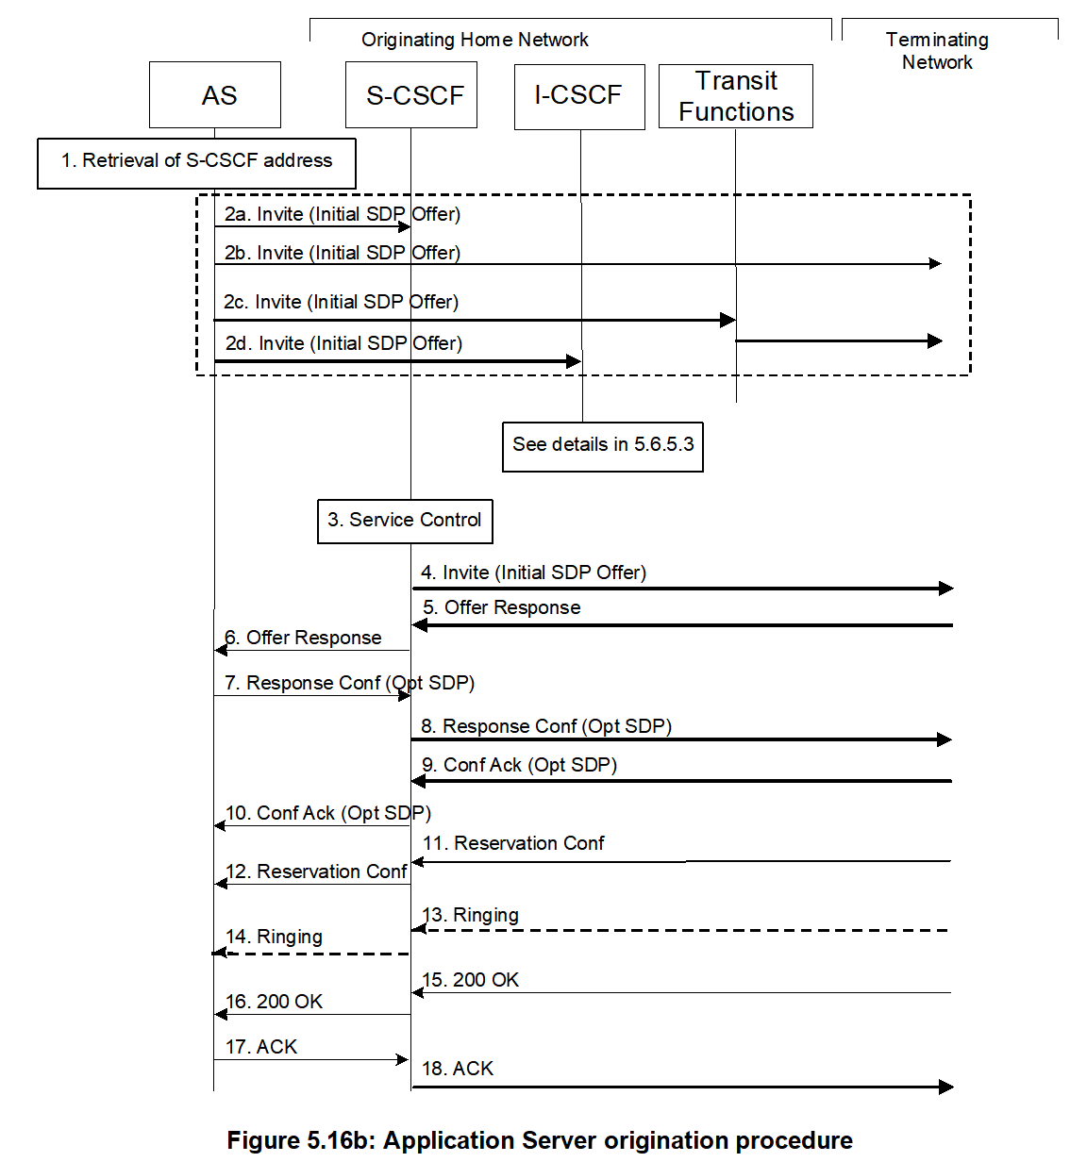
Technical Viability
-Click to Dial Query
The AS in the 3GPP specification can obtain messages such as ringing, 200OK, etc., as call status information.The AS can obtain these messages and then the call status information is transmitted to the APP. Details see 5.6.5.1 of TS 23.228.
Notes:
跟昱哥确认一下

Slide 11
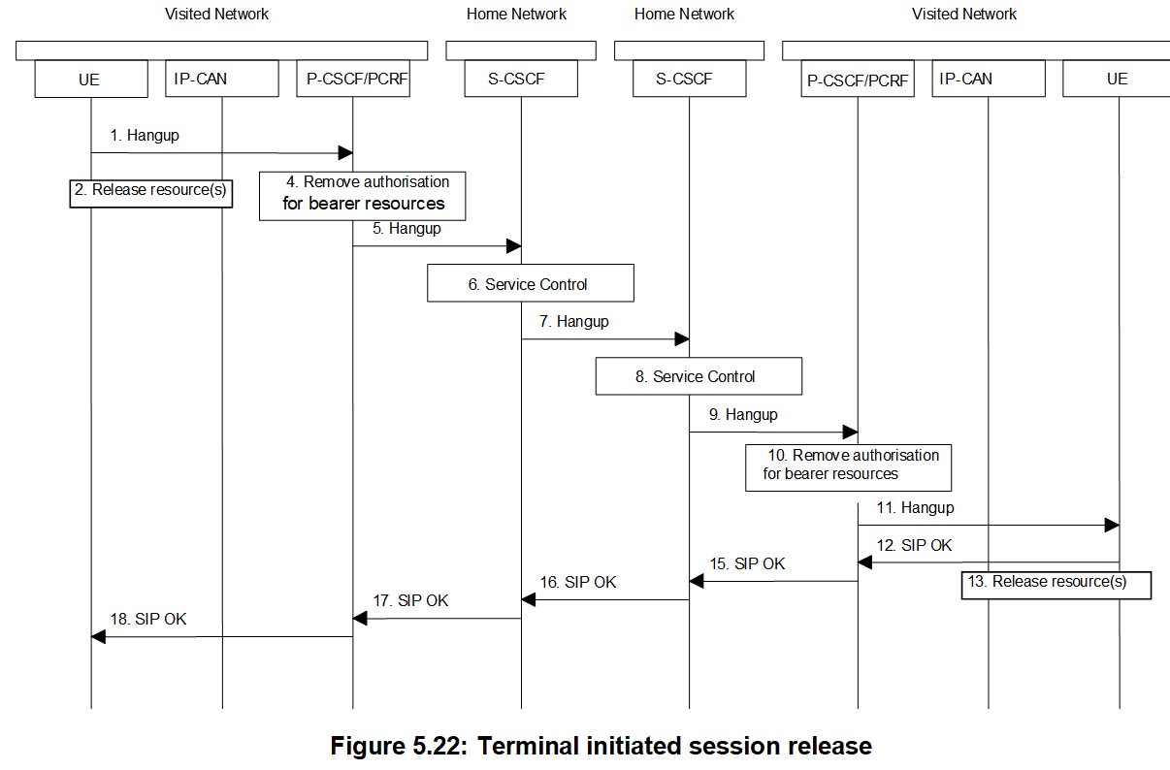
Technical Viability
-Click to Dial termination
The process for terminating click-to-dial can be found in 3GPP TS 23.228 5.10 Session release procedures
Notes:
跟昱哥确认一下，把规范里两方结束通话的流程放上来

